Slide 1
Simple approach to the relation between laser frequency noise and laser line shape
Di Domenico, G., Schilt, S., & Thomann, P. (2010). Simple approach to the relation between laser frequency noise and laser line shape. Applied Optics, 49(25), 4801. https://doi.org/10.1364/AO.49.004801
ZGS 180112

Slide 2
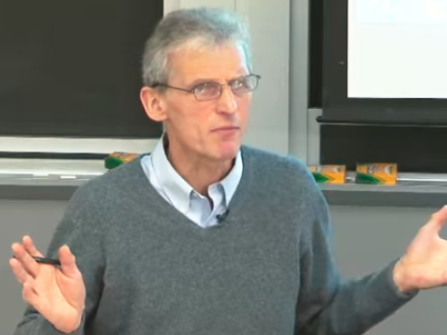
Clicker Question1
Are laser frequency noise and phase noise the same?
A: Yes
B: No
C: I don’t give a 💩

Slide 3
Clicker Question2
Does laser high frequency noise matter?
A: Yes
B: No
C: I don’t give a 💩

Slide 4

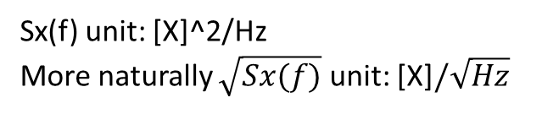
Power Spectrum Density (PSD)
Measuring Instrument Perspective
R. Paschotta, article on 'power spectral density' in the Encyclopedia of Laser Physics and Technology, 1. edition October 2008, Wiley-VCH, ISBN 978-3-527-40828-3

Slide 5


Power Spectrum Density (PSD)
Measuring Instrument Perspective
Analytical Perspective: g(1) correlation: Wiener-Khintchine
R. Paschotta, article on 'power spectral density' in the Encyclopedia of Laser Physics and Technology, 1. edition October 2008, Wiley-VCH, ISBN 978-3-527-40828-3

Slide 6



Laser Line Shape Definition
PSD of E(t)

Slide 7
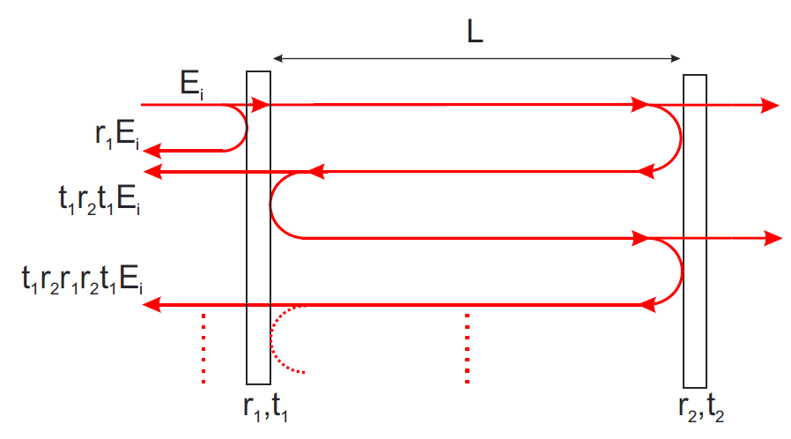

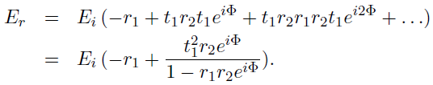


Frequency Descrimator: Cavity
Kirchmair, G. (2006). Frequency stabilization of a Titanium-Sapphire laser for precision spectroscopy on Calcium ions. Quantum Information Processing.

Slide 8

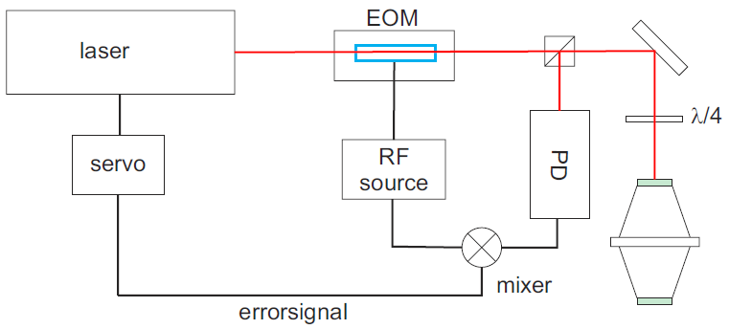
Frequency Modulation: Bias from 0
Kirchmair, G. (2006). Frequency stabilization of a Titanium-Sapphire laser for precision spectroscopy on Calcium ions. Quantum Information Processing.

Slide 9
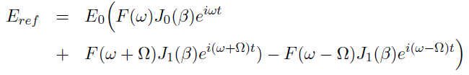
Frequency Modulation: Bias from 0
Kirchmair, G. (2006). Frequency stabilization of a Titanium-Sapphire laser for precision spectroscopy on Calcium ions. Quantum Information Processing.

Slide 10
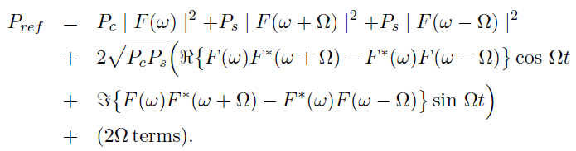
Frequency Modulation: Bias from 0
Kirchmair, G. (2006). Frequency stabilization of a Titanium-Sapphire laser for precision spectroscopy on Calcium ions. Quantum Information Processing.

Slide 11
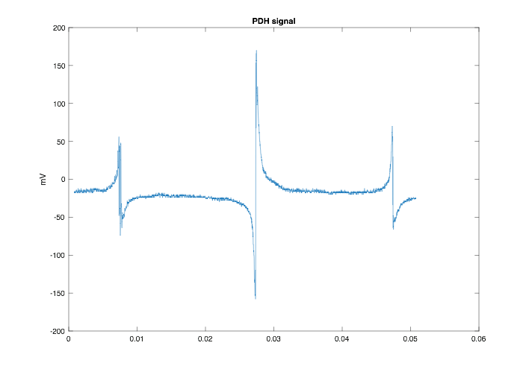
Frequency Modulation: Bias from 0
Kirchmair, G. (2006). Frequency stabilization of a Titanium-Sapphire laser for precision spectroscopy on Calcium ions. Quantum Information Processing.

Slide 12
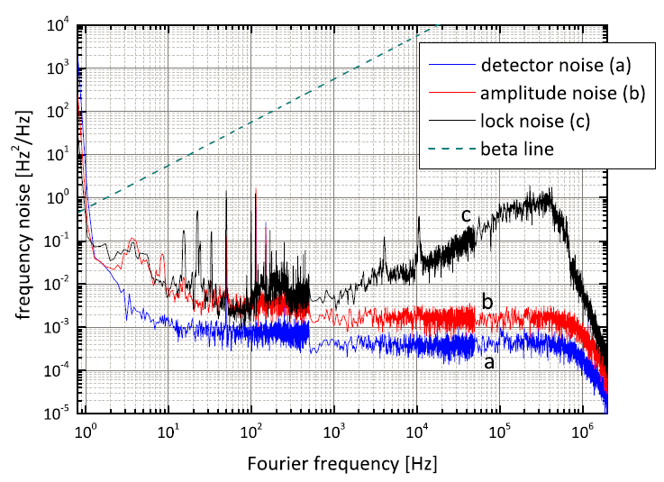
Frequency noise spectrum
Cappellini, G., Lombardi, P., Mancini, M., Pagano, G., Pizzocaro, M., Fallani, L., & Catani, J. (2015). A compact ultranarrow high-power laser system for experiments with 578 nm ytterbium clock transition. Review of Scientific Instruments, 86(7). https://doi.org/10.1063/1.4927165

Slide 13

Low Pass Filter Model
Sv(f)
h0
fc
f

Slide 14
Low Pass Filter Model
Sv(f)
h0
fc
f

Slide 15


Low Pass Filter Model
Large fc/h0 limit: Lorentzian line shape
Small fc/h0 limit: Gaussian line shape
Di Domenico, G., Schilt, S., & Thomann, P. (2010). Simple approach to the relation between laser frequency noise and laser line shape. Applied Optics, 49(25), 4801. https://doi.org/10.1364/AO.49.004801

Slide 16
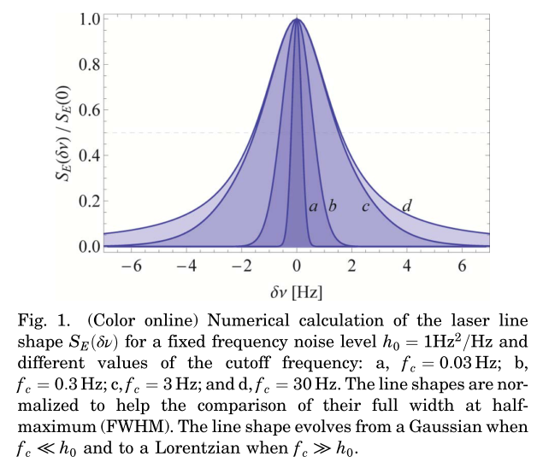
Low Pass Filter Model
Intermediate fc/h0 by numerical method
Di Domenico, G., Schilt, S., & Thomann, P. (2010). Simple approach to the relation between laser frequency noise and laser line shape. Applied Optics, 49(25), 4801. https://doi.org/10.1364/AO.49.004801

Slide 17
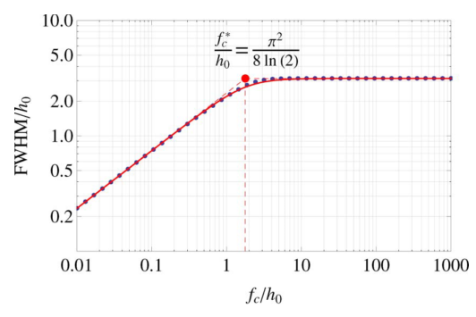

Low Pass Filter Model
Beta separation line
Di Domenico, G., Schilt, S., & Thomann, P. (2010). Simple approach to the relation between laser frequency noise and laser line shape. Applied Optics, 49(25), 4801. https://doi.org/10.1364/AO.49.004801

Slide 18
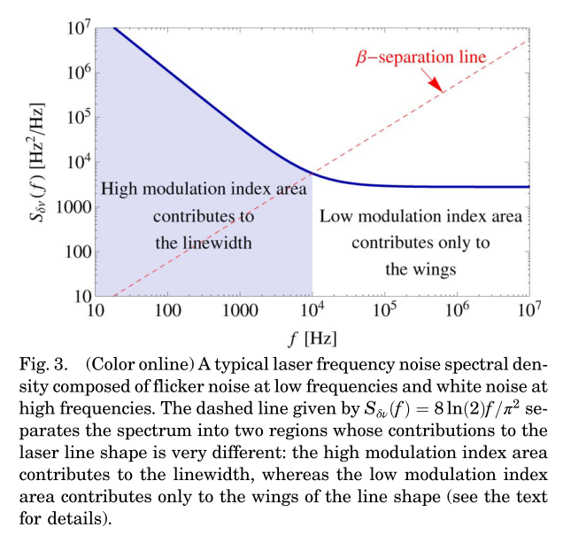
Beta Separation Line

Slide 19
Frequency noise spectrum
Cappellini, G., Lombardi, P., Mancini, M., Pagano, G., Pizzocaro, M., Fallani, L., & Catani, J. (2015). A compact ultranarrow high-power laser system for experiments with 578 nm ytterbium clock transition. Review of Scientific Instruments, 86(7). https://doi.org/10.1063/1.4927165

